Slide 1

Maximize the value of your well
Liang Chen(陈亮)
PIC Project -
Maxwell Metrics-based bug prediction model

Slide 2
TFS: Team Foundation Server
Development process: Agile
UI: User Interface
DV: Data Validation

Slide 3
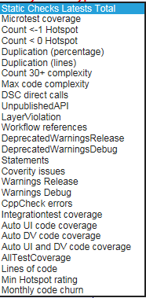
Key Quality Metrics
File/Class/Change-Set Size(LOC)
Code Churn
Code Complexity
Bug Density
Change Density
Change Frequency
Compiler Warnings
Duplications
Micro/Integration/UI/DV Coverage
Bug inflow/outflow/openflow
Severity of Bug
Bug Age
http://bgc-cimetrics.dir.slb.com/

Slide 4
Working Mode
Working Mode - Lean
Grasp key quality metrics
Define Problem
Data Collection
Build up Model
Examination
Build
Measure
Learn

Slide 5
References
<\\srv004bgc\MaxwellBAK\Acellere\Hotspot Reports\
Use of Relative Code Churn Measures to Predict System Defect Density
Source Monitor
The Influence of Organizational Structure on Software Quality: An Empirical Case Study
CODE CHURN DASHBOARD
\\srv004bgc\MaxwellBAK\Acellere\Hotspot Reports\

